Slide 1
Normalization(part-2)

Slide 2
Example 3: Determine NF
In your solution you will write the following justification:
There are M/V attributes; therefore, not 1NF
Conclusion: The relation is not normalized.
Part_ID → Description
Part_ID → Price
Part_ID, Comp_ID → No

Slide 3
Bringing a Relation to 1NF

Slide 4
Bringing a Relation to 1NF
Option 1: Make a determinant of the repeating group (or the multivalued attribute) a part of the primary key.
Composite Primary Key

Slide 5
Bringing a Relation to 1NF
Option 2: Remove the entire repeating group from the relation. Create another relation which would contain all the attributes of the repeating group, plus the primary key from the first relation. In this new relation, the primary key from the original relation and the determinant of the repeating group will comprise a primary key.

Slide 6
Bringing a Relation to 1NF

Slide 7
Bringing a Relation to 2NF
Composite Primary Key

Slide 8
Bringing a Relation to 2NF
Goal: Remove Partial Dependencies
Partial Dependencies
Composite Primary Key

Slide 9
Bringing a Relation to 2NF
Remove attributes that are dependent from the part but not the whole of the primary key from the original relation. For each partial dependency, create a new relation, with the corresponding part of the primary key from the original as the primary key.

Slide 10
Bringing a Relation to 2NF

Slide 11
Bringing a Relation to 3NF
Goal: Get rid of transitive dependencies.
Transitive Dependency

Slide 12
Bringing a Relation to 3NF
Remove the attributes, which are dependent on a non-key attribute, from the original relation. For each transitive dependency, create a new relation with the non-key attribute which is a determinant in the transitive dependency as a primary key, and the dependent non-key attribute as a dependent.

Slide 13
Bringing a Relation to 3NF

Slide 14
Unnormalised Normal Form (UNF)
ORDER (order-no, order-date, cust-no, cust-name, cust-add,
(prod-no, prod-desc, unit-price, ord-qty, line-total)*, order-total

Slide 15
First Normal Form (1NF)
Definition: A relation is in 1NF if, and only if, all its underlying attributes contain atomic values only.
Remove repeating groups into a new relation
A repeating group is shown by a pair of brackets within the relational schema.
ORDER (order-no, order-date, cust-no, cust-name, cust-add,
(prod-no, prod-desc, unit-price, ord-qty, line-total)*, order-total
Steps from UNF to 1NF:
Remove the outermost repeating group (and any nested repeated groups it may contain) and create a new relation to contain it.
Add to this relation a copy of the PK of the relation immediately enclosing it.
Name the new entity (appending the number 1 to indicate 1NF)
Determine the PK of the new entity
Repeat steps until no more repeating groups.

Slide 16
Example - UNF to 1NF
ORDER (order-no, order-date, cust-no, cust-name, cust-add,
(prod-no, prod-desc, unit-price, ord-qty, line-total)*, order-total
1. Remove the outermost repeating group (and any nested repeated groups it may contain) and create a new relation to contain it. (rename original to indicate 1NF)
ORDER-1 (order-no, order-date, cust-no, cust-name, cust-add, order-total
(prod-no, prod-desc, unit-price, ord-qty, line-total)
2. Add to this relation a copy of the PK of the relation immediately enclosing it.
ORDER-1 (order-no, order-date, cust-no, cust-name, cust-add, order-total
(order-no, prod-no, prod-desc, unit-price, ord-qty, line-total)
3. Name the new entity (appending the number 1 to indicate 1NF)
ORDER-LINE-1 (order-no, prod-no, prod-desc, unit-price, ord-qty, line-total)
4. Determine the PK of the new entity
ORDER-LINE-1 (order-no, prod-no, prod-desc, unit-price, ord-qty, line-total)

Slide 17
Second Normal Form (2NF)
Definition: A relation is in 2NF if, and only if, it is in 1NF and every non-key attribute is fully dependent on the primary key.
Remove partial functional dependencies into a new relation
Steps from 1NF to 2NF:
Remove the offending attributes that are only partially functionally dependent on the composite key, and place them in a new relation.
Add to this relation a copy of the attribute(s) which are the determinants of these offending attributes. These will automatically become the primary key of this new relation.
Name the new entity (appending the number 2 to indicate 2NF)
Rename the original entity (ending with a 2 to indicate 2NF)

Slide 18
Example - 1NF to 2NF
ORDER-LINE-1 (order-no, prod-no, prod-desc, unit-price, ord-qty, line-total)
1. Remove the offending attributes that are only partially functionally dependent on the composite key, and place them in a new relation.
ORDER-LINE-1 (order-no, prod-no, ord-qty, line-total)
(prod-desc, unit-price)
2. Add to this relation a copy of the attribute(s) which determines these offending attributes. These will automatically become the primary key of this new relation..
ORDER-LINE-1 (order-no, prod-no, ord-qty, line-total)
(prod-no, prod-desc, unit-price)
3. Name the new entity (appending the number 2 to indicate 2NF)
PRODUCT-2 (prod-no, prod-desc, unit-price)
4. Rename the original entity (ending with a 2 to indicate 2NF)
ORDER-LINE-2 (order-no, prod-no, ord-qty, line-total)

Slide 19
Third Normal Form (3NF)
Definition: A relation is in 3NF if, and only if, it is in 2NF and every non-key attribute is non-transitively dependent on the primary key.
Remove transitive dependencies into a new relation
Steps from 2NF to 3NF:
Remove the offending attributes that are transitively dependent on non-key attribute(s), and place them in a new relation.
Add to this relation a copy of the attribute(s) which are the determinants of these offending attributes. These will automatically become the primary key of this new relation.
Name the new entity (appending the number 3 to indicate 3NF)
Rename the original entity (ending with a 3 to indicate 3NF)

Slide 20
Example - 2NF to 3NF
ORDER-2 (order-no, order-date, cust-no, cust-name, cust-add, order-total
1. Remove the offending attributes that are transitively dependent on non-key attributes, and place them in a new relation.
ORDER-2 (order-no, order-date, cust-no, order-total
(cust-name, cust-add )
2. Add to this relation a copy of the attribute(s) which determines these offending attributes. These will automatically become the primary key of this new relation..
ORDER-2 (order-no, order-date, cust-no, order-total
(cust-no, cust-name, cust-add )
3. Name the new entity (appending the number 3 to indicate 3NF)
CUSTOMER-3 (cust-no, cust-name, cust-add )
4. Rename the original entity (ending with a 3 to indicate 3NF)
ORDER-3 (order-no, order-date, cust-no, order-total

Slide 21
Example - Relations in 3NF
ORDER-3 (order-no, order-date, cust-no, order-total
CUSTOMER-3 (cust-no, cust-name, cust-add )
PRODUCT-2 (prod-no, prod-desc, unit-price)
ORDER-LINE-2 (order-no, prod-no, ord-qty, line-total)
prod-no
order-no
PRODUCT
ORDER
places
contains
shows
placed by
belongs to
cust-no
order-no, prod-no
CUSTOMER
part of
ORDER-LINE

Slide 22
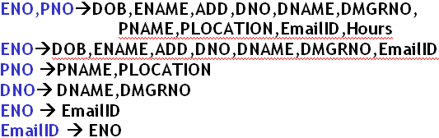
Case Study on Normalization
Consider the table
EMP_DEPT_PROJ
And the following dependencies which exist in the above table:

Slide 23
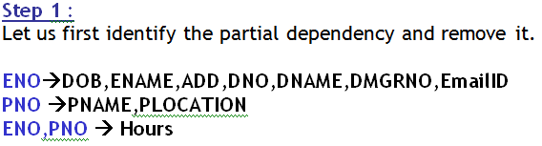
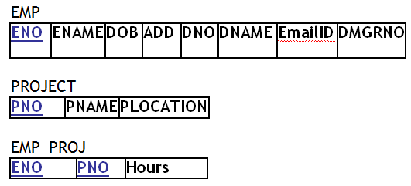
Steps to Normalize the database
D
Thus we will have 3 tables

Slide 24
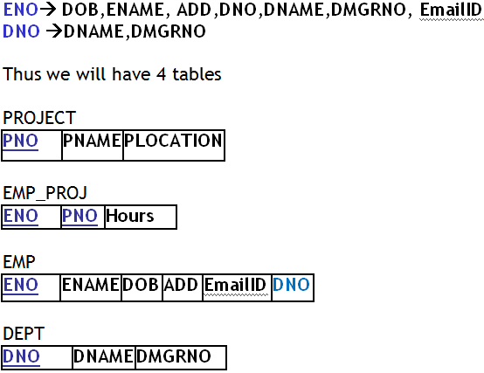
Steps to Normalize the database
Step 2
Let us now identify the transitive dependency and remove it.

Slide 25

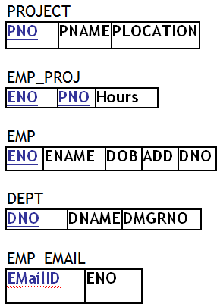
Steps to Normalize the database
Step 3:
Let us now identify the non key determinants and remove them.
Thus we will have 5 tables

Slide 26
Thanks

